Slide 1
ObstacleOutrun
Blitz Team
Here is the intermediate presentation of our game

Slide 2


Slide 3
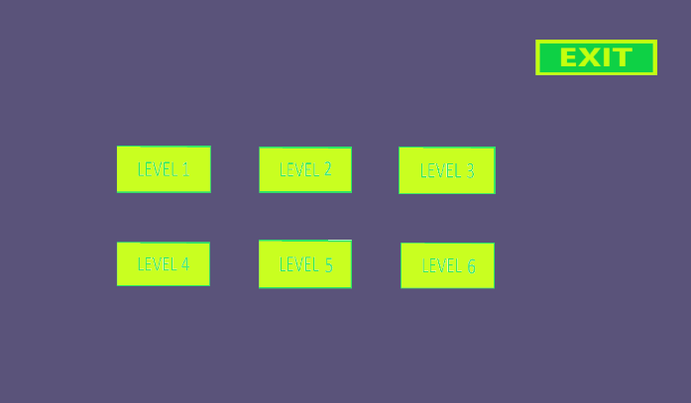

Slide 4


Slide 5


Slide 6


Slide 7


